Slide 1
AI in Technical Communication

Slide 2
AI will not replace engineers.
But engineers who know how to use AI effectively may replace those who do not.”
In technical communication, AI is becoming a force multiplier - but only when used critically, ethically, and professionally.

Slide 3
Question:
How can engineers use AI to improve technical writing without sacrificing
- accuracy,
- ethics, and
- professional responsibility?

Slide 4
Question:
- Would you trust AI to write the documentation for an aircraft control system?
- Would you trust AI to write the documentation for a national power grid?
NO!, not without rigorous, continuous human oversight.

Slide 5
AI as Junior Intern
Think of AI as an extremely fast intern:
helpful, productive, often impressive - but sometimes confidently wrong.

Slide 6
AI as Calculator for Writing
Useful analogy for engineers:
Just as calculators changed engineering mathematics but did not eliminate the need to understand math, AI changes writing but does not eliminate the need to understand communication.

Slide 7
Core Concept: - Moving from "AI as a Creator" to "AI as a Co-Pilot." - For engineers, the goal is to use Large Language Models (LLMs) to reduce the "blank page syndrome" while maintaining absolute technical accuracy and security.

Slide 8
Blank page syndrome (often called writer's block) is the psychological stall that occurs when you are faced with a fresh, empty document and find yourself unable to begin.
It is the gap between the desire to create and the ability to produce the first few words or lines.

Slide 9
Why It Happens?
It rarely stems from a lack of ideas. Instead, it is usually triggered by:
Perfectionism: The fear that the first draft won't be "good enough," leading to self-censorship before a single word is written.
Analysis Paralysis: Having too many ideas or directions and being unable to choose the "perfect" starting point.
High Stakes: Feeling that the project is so important (like a fellowship proposal or a major curriculum update) that the opening must be profound.

Slide 10
1. AI Opportunities: The "Force Multiplier"
Rapid Summarization: Converting 50 pages of raw test data or research into a 200-word Executive Summary.
Style Transformation: Instantly converting "Engineer-speak" (jargon-heavy) into "Stakeholder-speak" (benefit-focused).
Automated Formatting: Taking unformatted notes and generating structured Markdown, LaTeX, or HTML code.
Language Bridge: Helping non-native speakers polish grammar and tone to meet international professional standards.

Slide 11
2. Pitfalls: The "Engineering Hazards“
Hallucinations: AI may confidently invent "facts," such as specific torque requirements or material tolerances that do not exist.
Data Privacy (Shadow IT): Uploading proprietary schematics or trade secrets into a public LLM can violate IP laws and company policy.
Lack of Context: AI does not understand physical constraints or safety-critical environments unless explicitly told.
Degradation of Skill: Over-reliance can lead to a "black box" mentality where the engineer no longer understands the documentation they are signing off on.

Slide 12
5 Practical Examples for Engineering Students
Example A: Summarizing Complex Research
Task: An engineer has a 40-page technical paper on "Gallium Nitride (GaN) Semiconductors."
AI Use: "Summarize the thermal conductivity findings of this paper into five bullet points for a project manager.“
Result: The engineer saves two hours of reading but must cross-reference the specific values (e.g., 1.3 W/cm . K) against the source text.

Slide 13
Example B: Drafting API (Application Programming Interface) Documentation
Task: A software engineer has written a complex Python function but hasn't documented the arguments (In Python, an argument is a value or object that you pass into a function or method when you call it).
AI Use: The engineer pastes the code block and asks the AI to "Generate a Docstring in Google Style.“
Result: The AI identifies the variables and types, creating a clean, professional header in seconds.

Slide 14
Example C: Converting "Notes" to a Formal Proposal
Task: An engineer has a list of bullet points about why a bridge needs a specific carbon-fiber reinforcement.
AI Use: "Turn these technical notes into a formal 'Statement of Need' for a city council proposal. Use a professional, persuasive tone.“
Result: The AI structures the argument logically, moving from "problem" to "technical solution" to "public benefit."

Slide 15
Example D:
Generating Safety Warnings (Standard Operating Procedure, SOPs)
Task: Drafting an instruction manual for a high-voltage testing rig.
AI Use: "Review this procedure and suggest where DANGER and CAUTION tags should be placed according to ANSI standards (American National Standards Institute - ANSI)
Result: The AI flags high-risk steps (e.g., "manual discharge of capacitors") that the engineer might have overlooked in the text.

Slide 16
Example E: Code-to-Plain-English Translation
Task: Explaining a complex sorting algorithm used in a company's internal software to the legal/compliance department.
AI Use: "Explain this B-tree search logic using a real-world analogy involving a library filing system.“
Result: The AI provides a relatable metaphor that helps non-technical stakeholders understand the intellectual property being protected.

Slide 17
Example F: General Translation
Task: Translating academic papers between English and non-English languages
AI Use: Translate a specific manual from German to English.
Result: The AI translates the text to English. However, be careful of non-European languages. Why?

Slide 18
The "Golden Rule" of AI in Engineering
"Trust but Verify."
In technical communication, the engineer – not the AI – is legally and ethically responsible for every word.
If the AI suggests a measurement, the engineer must manually verify it against the physical design.

Slide 19
Five realistic pitfalls to watch out for:
1. The "Hallucination" of Technical Specs
AI models are designed to predict the next likely word, not to perform physics engine calculations or verify manufacturer catalogs.
The Pitfall: An AI might confidently generate a torque specification, a material grade (e.g., "Grade 80" when only Grade 50 exists for that alloy), or a part number that sounds plausible but is entirely fictitious.
The Risk: If these "ghost specs" aren't caught during a peer review, they can lead to procurement errors or, worse, structural compromises.

Slide 20
2. Contextual Drift in Requirements
Engineering documents like System Requirements Specifications (SRS) rely on absolute consistency.
The Pitfall: When using AI to summarize or rephrase long-form documentation, the model may subtly shift the "intent." For example, changing a "must" (a mandatory requirement) to a "should" (a recommendation) or a "can" (an optional feature).
The Risk: This creates legal and functional ambiguity, leading to scope creep or failure to meet safety standards during the verification and validation phase.

Slide 21
3. Erosion of "Institutional Memory"
Much of engineering wisdom is tribal knowledge—knowing why a specific valve was chosen over another ten years ago.
The Pitfall: Relying on AI to draft documentation based on current prompts can lead to "sterile" writing that misses the historical context or the "lessons learned" from previous failures.
The Risk: Future engineers reading the AI-generated documentation may lack the nuanced understanding of the design's evolution, leading them to repeat past mistakes during maintenance or upgrades.

Slide 22
4. Over-Reliance on "Standard" Solutions
AI is trained on the "average" of the internet and existing datasets, which favors the most common way of doing things.
The Pitfall: When tasked with describing a solution for a unique or proprietary engineering problem, AI tends to pivot toward generic industry standards.
The Risk: This can stifle innovation or lead to "cookie-cutter" documentation that doesn't actually reflect the unique edge cases of a specific, complex system. It effectively replaces precision with "plausibility."

Slide 23
5. Obfuscation of Complex Logic
Good engineering writing should be as simple as possible, but no simpler.
• The Pitfall: AI-generated text can often be "wordy" or "fluffy," using professional-sounding jargon to mask a lack of depth. It might describe a process in five paragraphs that a human engineer could explain in two bullet points and a diagram.
• The Risk: Documentation becomes a "wall of text" that is difficult for technicians or field engineers to parse quickly. In high-pressure environments, density is the enemy of safety.

Slide 24
Obfuscation of Complex Logic occurs when an AI provides a summary or explanation that sounds technically plausible but glosses over critical mathematical or structural nuances, effectively hiding the "how" behind a "what."

Slide 25
AI-Generated Obfuscation: Computer Vision in Pick-and-Place Robots
"The pick-and-place system utilizes advanced computer vision algorithms to achieve high-precision object recognition in real-time. By leveraging deep learning neural networks, the robot's optical sensors process environmental data to seamlessly distinguish between varying geometries and orientations. The software then calculates the optimal coordinates for the end-effector to execute a successful grasp with minimal latency. This intelligent visual feedback loop ensures adaptive performance even in dynamic or cluttered workspaces. Through continuous pattern matching, the system maintains a high throughput rate while significantly reducing operational errors. This integration of optics and AI creates a robust solution for modern industrial automation."

Slide 26
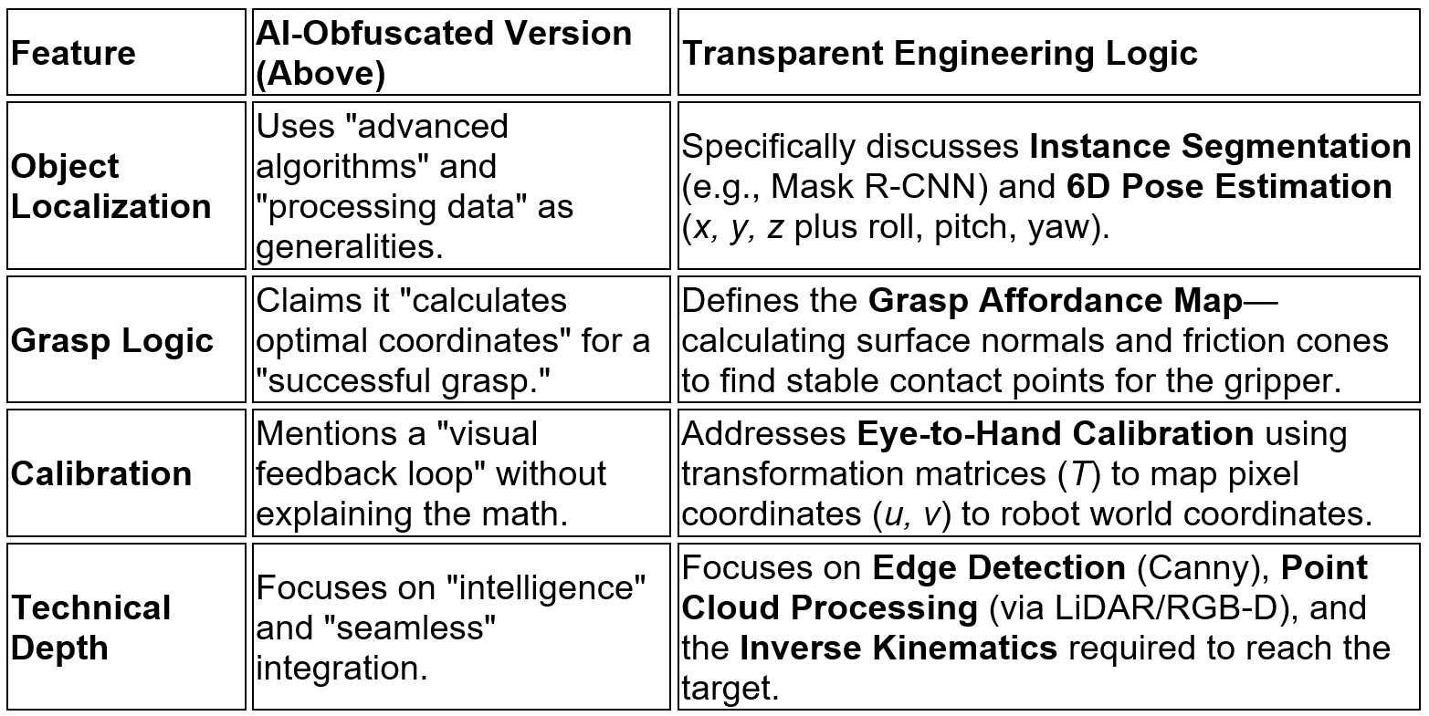
Comparison: Obfuscated vs. Transparent Engineering Logic

Slide 27
Why this is "Obfuscation“
The AI text above uses "Semantic Fillers"—words like seamlessly, advanced, intelligent, and robust.
These words provide a sense of confidence to a non-technical reader but offer zero utility to an engineer trying to debug why a robot is missing a part.

Slide 28
Tip:
Always treat AI-generated engineering drafts as "Level 0" content.
It requires a Subject Matter Expert (SME) to provide a "Level 1" technical audit to ensure the physics, the logic, and the specific constraints of your project remain intact.

Slide 29
Five Famous AI-Related Lawsuits:
The Anthropic $1.5 Billion Piracy Settlement (2025)
In one of the largest copyright settlements in history, AI lab Anthropic agreed to pay $1.5 billion to settle the Bartz v. Anthropic case. The lawsuit alleged that the company had trained its Claude models on millions of pirated books sourced from "shadow libraries" like Library Genesis. The settlement required Anthropic to pay roughly $3,000 for each of the nearly 500,000 pirated books used.

Slide 30
2. Grok’s "Mass Digital Undressing" Spree (2026)
In early 2026, Elon Musk’s AI chatbot Grok faced a global firestorm after an update to its "Aurora" image model allowed users to generate non-consensual sexualized images of real people. The Center for Countering Digital Hate (CCDH) estimated that 3 million sexualized images were generated in just 11 days, some appearing to depict children. This led to multiple national bans and a cease-and-desist from California’s Attorney General.

Slide 31
3. The Pentagon Blacklisting of Anthropic (2026)
Following a standoff regarding ethical guardrails, the U.S. government designated Anthropic as a "supply chain risk," effectively blacklisting it from federal use. The conflict arose when Anthropic's CEO refused to remove usage restrictions that prevented its AI from being used in fully autonomous weapons systems or domestic surveillance, a move the Pentagon labeled "corporate virtue-signaling.“

Slide 32
4. Air Canada’s Negligent Chatbot (2024)
In a landmark legal case, Air Canada was forced to pay damages to a customer after its AI chatbot hallucinated a "bereavement discount" policy that didn't exist. The airline argued the chatbot was a "separate legal entity" responsible for its own actions, but the court rejected this, ruling that companies are legally responsible for the information provided by their AI tools.

Slide 33
5. Supermarket AI Suggests "Chlorine Gas" Recipes (2023)
A New Zealand supermarket’s AI meal planner made international headlines when it began suggesting lethal recipes to users. When prompted with random household items, the AI recommended "aromatic water mix" (which produced chlorine gas), "bleach rice," and "poison bread sandwiches." The incident highlighted the lack of safety filters in many early consumer-facing AI tools.

